Slide 1

TDS / TCS
Controversies
&
Issues
A Presentation by →
K.M. SHAHI, I.T.O. 6(1)-1, MUMBAI

Slide 2
TDS / TCS : SCOPE
CHAPTER XVII-B.
SECTIONs 190 TO 206
A SEPARATE CODE

Slide 3

Objective behind TDS
Pay as you Earn
Regular Cash Inflow
Participative Action
Avoid Evasion
Shift the Responsibility
Widening of Tax Base
3
Notes:
3
Concept ‘PAY AS YOU EARN’
To have a regular flow of cash
To pre-pone collection of taxes
To prevent evasion of taxes
To widen the network for collection of tax
(i.e. to increase Tax Net)
To shift the responsibility of deducting and depositing of taxes to person other than tax payers

Slide 4
PROLOGUE……
TDS IS SIMPLE &
NOT TEDIOUS/CONTROVERSIAL
T
D
S
HREE
EE
YSTEM

Slide 5
T
D
S
HREE
EE
YSTEM
Deduct
AS PER PROVISIONS OF Ch. XVII-B
Deposit
WITHIN DUE DATEs
Declare
By FILING TDS STATEMENTS

Slide 6
T
D
S
HREE
EE
YSTEM
Deduct
AS PER PROVISIONS OF Ch. XVII-B
DEDUCTORS NOT TO INTERPRET
AVOID NARROW INTERPRETATIONS
CONTACT A.O.(TDS) IN DOUBTS
AVOID PENAL PROVISIONS
AVOID PROSECUTIONS

Slide 7
T
D
S
HREE
EE
YSTEM
Deposit
WITHIN DUE DATEs
Due date of deposit for Non-Government deductors
Type | Old due date | New Due date
TDS for the months of April to February | 07th of Next month | 07th of Next month
TDS on normal entries of March | 07th of Next month | 30th April
TDS on Provisional/Credit entries of March | 30th May | 30th April

Slide 8
T
D
S
HREE
EE
YSTEM
Declare
By FILING TDS STATEMENTS
Due date for filing TDS statement
 | up to F.Y. 2009-10 | F.Y. 2010-11 onwards
Quarter 1 | July 15 | July 15
Quarter 2 | October 15 | October 15
Quarter 3 | January 15 | January 15
Quarter 4 | June 15 | May 15

Slide 9
TDS PROVISIONS: AT A GLANCE
DEDUCT
AS PER
CH.-XVII-B
DEPOSIT
BEFORE DUE DATES
DECLARE
BEFORE DUE DATES
Timeline→ Timeline→
OK?
YES
OK?
YES
OK?
YES
NO
NO
NO
Deemed default u/s. 201(1)
Penalty u/s. 271C/271CA
  To the extent of TDS
Interest u/s. 201(1A)
  @1% till Dt of Deduction
  @1.5% till Dt of deposit
Prosecution u/s. 276B
  RI :3 months to 7years
Penalty u/s. 272A(2)(k)
  @100/- per day
  To the extent of TDS

Slide 10
TDS PROVISIONS: AT A GLANCE
Failure to
Furnish
Form 16/ 16A
203A- Failure to Apply for / Quote TAN
Failure to Deduct Tax
Events → Events→
Penalty u/s. 272A(2)(g)
  @100/- per day
  Till default continues
Penalty u/s. 272BB
  Rs. 10,000/-
Disallowance u/s. 40(a)(ia)
  Entire Expense
  @ applicable rate

Slide 11
Some Points of Concerns of Deductors
Agents of Government without remuneration.
No reward for Collection of Revenue for Govt.
Onerous and Complex Responsibility.
Penal Consequence in case of default:-
  Interest u/s. 201(1A) of the Act.
  Penalties.
  Prosecution u/s. 276
  Disallowance of Expenses u/s. 40(a)(ia)
11

Slide 12
Some Points of Concerns for Department
Claim for commission/ reward as remuneration.
Erroneous Interpretation of legal provisions
Errors in Data Uploading by deductors
Lack of technical skill/ knowledge
Poor response of deductor to TDS Notices/ Letters
Huge TDS database to handle with very less resource
  Skilled Manpower
  Infrastructure
12

Slide 13
TYPES OF
CONTROVERSIES
LEGAL
TECHNICAL
PROCEDURAL

Slide 14
LEGAL
CONTROVERSIES
“I am the country’s draftsman, I draft the country’s laws and for more than half the litigation I am responsible”
→ Justice Sujata Manohar

Slide 15
LEGAL CONTROVERSIES : PLAYERS
1.
LEGISLATION
3.
PROFESSIONAL
2.
EXECUTIVE
4.
DEDUCTOR

Slide 16
CAUSES FOR
LEGAL CONTROVERSIES
Frequent Amendments
Circulars & Notifications
Prejudiced
Interpretations
Legal Precedents

Slide 17
SOME LEGAL CONTROVERSIES
194c versus Other Sec.
Demand u/s.201(1)
Interest on Interest
TDS Survey/ Inspection

Slide 18
How to reduce
LEGAL CONTROVERSIES ?
Simplification of Act
Standardization of TDS Rates
Liberal
Interpretations
Positive Approach
DTC
x % ?
Pro-revenue
Participative

Slide 19
VISION 2020
To partner in Nation building process through-
Progressive tax policy,
efficient and effective administration &
improving voluntary compliance.

Slide 20
OUR VALUES
Integrity | Being honest and transparent in our dealings with taxpayers and others.
Responsiveness | Being sensitive, prompt and understanding in all our dealings so as to foster mutual trust.
Fairness | Being objective and reasonable in our actions and decisions.
Accountability | Ensuring that our actions stand the test of scrutiny & review.
Innovation | Continuously seeking new ways to achieve our mission.
Professionalism | Strive to improve performance and competence with focus on achieving excellence.

Slide 21
STRATEGIES
1. Strategic Technology Initiative (Automation/Computerization)
2. Real Time Knowledge Management & Sharing
3. Incorporating Taxpayer Perspectives to Improve Service Delivery
4. Creating Suitable Channel Strategy for Taxpayers ( I am here)
5. Single Window Facility for Taxpayers (ASKs/ Call Centres)
6. Strengthening Partnership with Tax Practitioners/ Deductors
(Forming Tax Advisory Councils….)
7. Litigation Management ( JRS/ DRP/ Transfer Pricing etc.)

Slide 22
DEFAULT U/S. 201(1)/
MISMATCH U/S. 200A
NATURE
&
REMEDIES

Slide 23
DEFAULTS u/s. 201(1)
or
MISMATCHES u/s. 200A
Reasons for Default
Types of Default
How to Correct?
What is the Advantage?

Slide 24
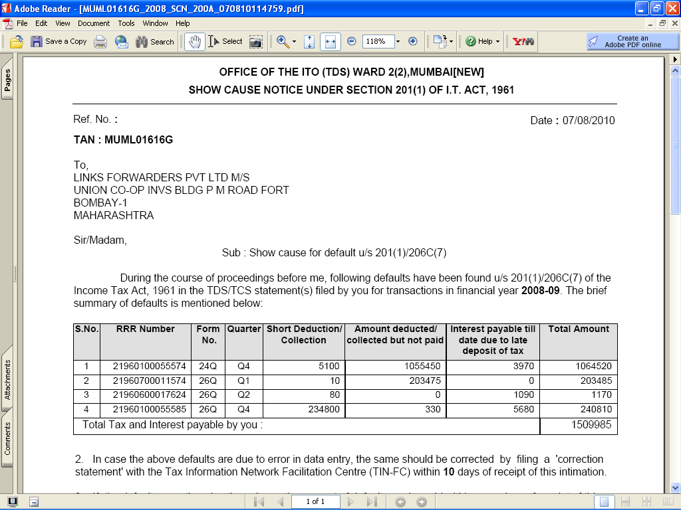
Show Cause Notice U/s. 201(1) of I.T. Act, 1961

Slide 25
How do we react to Show Cause Notice (SCN) from TDS ?
A. Treat it like any other Notice.
B. SCN is outcome of ‘system’ trouble.
C. SCN is a mischief by Assessing Officer (TDS)
D. No need to bother, once the dues have been paid.

Slide 26


Deductor’s Response to Show-Cause Notice?
Response is very poor: In about 20→25% cases
Photocopy of Return/ Challans are enclosed.
No attention paid to the direction in SCN
Person who attends, knows nothing about TDS
Generally, system is blamed………….

Slide 27
Show Cause Notice U/s. 201(1) of I.T. Act, 1961

Slide 28
Default details
Download of default - Generated in Excel format from TIN-NSDL site
Facility available for registered TANs
Default details contains:
  List of short deduction records
  List of short payment records
  List of late payment records

Slide 29
Reasons for Default – Steps involved (TDS Statement)
OLTAS [ Containing CIN]
TAN
AMOUNT
BSR CODE
CHALLAN SR. NO.
DATE OF DEPOSIT
DEDUCTOR
Banks
DEDUCTEE
Deposits TDS
TDS Statement
TIN-FC
@
NSDL
Statement+OLTAS
ITD SYSTEM
Challan Status
PROCESSING
Stmt Status
Consol File
Form 16A
?
MATCHED…
END
CREDIT…
Default Detail
NO
Wrong PAN
26AS VIEW / FORM 16A
Correction Statement
SHOWCAUSE/
INTIMATION BY A.O.
Showcause 201(1)/ Intimation 200A

Slide 30
The Responsibility of Data Handling
BANKS
DEDUCTORS
CIN Details –
TAN
AMOUNT
BSR Code
Challan Sr. No.
Date of Deposit
CIN Details –
+
Deductee Details
(in Annexure)
TIN - NSDL
BULK PROCESSING ON ITD SYSTEM

Slide 31
Possibility of Error while Data Handling
BANKS
DEDUCTORS
CIN Details –
TAN
AMOUNT
BSR Code
Challan Sr. No.
Date of Deposit
CIN Details
+
Deductee Details
Computerized
➔ Less probable
Manual
➔ More probable

Slide 32
Possibility of Error while Data Handling
BANKS (10%) [Assigning Equal Weightage to Each Variables ]
TAN
AMOUNT
BSR Code
Challan Sr. No.
Date of Deposit
TAN→ Manual : Bank/Assessee
Amount → Computerized/Matched
BSR Code → Computerized
Challan Sr. No. → Computerized
Date → Computerized

Slide 33
Possibility of Error while Data Handling
Deductor (90%)
CIN Info-Manual
TAN
AMOUNT
BSR Code
Challan Sr. No.
Date of Deposit
Deductee Details-
PAN
Section
Amount
Date of Deduction
Date of Deposit
Some Common Errors
Challan Splitting
Challan Combining
Wrong TAN/PAN data
Wrong Amount
Wrong Challan Sr. No.
Wrong Date
Wrong Section/Sub-section
Non-Marking → “A”/ “P”/ “B”/ “C” etc.

Slide 34
Types of Default
Short
deduction
Non-marking of “A” deduction (197 Cases)
Quoting Incorrect Section/Sub-section
Referring to an outdated Rate chart
Considering wrong amount of payment
Wrong amount of Payment
Indicating wrong Deductee code
Wrong gender of Employee
Wrong Salary / Exemption information
Quoting Invalid PAN (FY 2010-11 onwards)

Slide 35
Types of Default
Late
Payment
Non-marking of “B” for 4th Quarter
E-payment after 11:00 p.m.
No interest paid in case of delay
Less interest paid for delayed payment
Wrong CIN quoted for Interest Challans
Wrong linking of Challan – Deductions
TDS paid by cheque, realized after due date
TDS paid 1 day late, bank holiday on due date.

Slide 36
Types of Default
Short Payment / Non-
Payment
Splitting of Challan
Combining of Challan
Practically not paid and applied some dummy CIN
Mistake in quoting the CIN*
Wrong Minor Code
*Challan Identification Number Contains→
TAN +
AMOUNT +
DATE OF DEPOSIT +
BSR CODE +
CHALLAN SR. NO.

Slide 37
Rectification of Errors
Deductor
Files
CORRECTION
STATEMENT
मदिरालय जाने को घर से चलता है पीनेवाला,
किस पथ से जाऊँ? असमंजस में है वह भोलाभाला,
अलग- अलग पथ बतलाते सब, पर मैं यह बतलाता हूँ -
राह पकड़ तू एक चला चल, पा जाएगा मधुशाला.'
RETURN
IS
PROCESSED
Default
Is
Removed

Slide 38
Rectification of Errors
TYPES OF CORRECTIONS
CHALLAN DETAILS
TDS
STATEMENTS
ASSESSING
OFFICER
BANK
DEDUCTOR

Slide 39
Rectification of Errors
CORRECTIONS IN CHALLAN DETAILS
ASSESSING
OFFICERS
(TDS)
ASSESSMENT YEAR
TAN
SECTION CODE (94C/94J etc.)
MINOR HEAD CODE (400/200)
BANKS
NAME OF THE DEDUCTOR
AMOUNT
MAJOR HEAD CODE (20/21)
From Sept ‘2011, the Banks are allowed to correct A.Y. , TAN Section Code & Minor Head code , if approached within 7 days.

Slide 40
From 01st Sept. 2011, the Banks are allowed to correct
Errors in PHYSICAL Challan as under
Correction Reqd. | Time-limit from Challan Deposit date
TAN/PAN | Within 7 days
Assessment Year | Within 7 days
Amount | Within 7 days
Other fields (Major Head, Minor Head, Nature of payment) | Within 3 months
The time window for correction by the bank is 7 days from the date of receipt of correction request from the tax-payer.

Slide 41
Rectification of Errors
CORRECTIONS IN e-TDS STATEMENT
D
E
D
U
C
T
O
R
S
Download consolidated TDS/TCS File.
  Register your TAN with NSDL (one-time)
  Log-in to obtain the following:-
    Consolidated TDS/TCS file
    Form 16A download
    Default Details
Prepare the correction in same
File the corrected file with TIN-FC
Check the status after filing

Slide 42
Rectification of Errors
Points to be remember while depositing TDS/TCS
Select correct minor head code (200) while making TDS/TCS deposits
Select correct minor head code (400) while making regular TDS/TCS payments arising out of Order u/s. 201(1)/201(1A)/271C or 272A(2)(k) etc.
Ensure due diligence in quoting TAN, section code and Assessment Year while making TDS/TCS deposits
For deducting TDS/TCS refer to latest chart/rules for TDS/TCS rates
On due date, deposit tax before 23.00 hours ( i.e. 11:00 p.m.) to avoid interest for late payment.

Slide 43
Reasons for Rejection of Correction Statement
Incorrect verification values
Incorrect quoting of provisional receipt number
Correction on booked transfer voucher / challan (other than section code)
Incorrect sequence no. of challan / deductee/ salary detail
Correction on deleted records
Correction on rejected regular statement

Slide 44
Rectification of Errors: Consolidated TDS/TCS File
Available to registered TANs at TIN
Mandatory from June 2010-11 to prepare correction return with consolidated TDS/TCS file
Available on online request and successful verification
Consolidated file provided by TIN includes
  all the updates done vide correction statements (accepted at TIN central system) filed by deductor/ collector
Consolidated TDS/TCS file is
  emailed at email ID in TAN account
  available for instant download
eTutorial on TAN registration and Consolidated file request on TIN website

Slide 45
TDS / TCS – Good Practice
Insist for PAN of deductee / employee
Verify PAN of deductee / employee before quoting in TDS/TCS return
Report all transactions where tax is deducted/collected
In case PAN of the deductee / employee is not available;
  deduct tax at higher rate
  report such transactions in the TDS/TCS return with flag ‘C’ indicating tax deducted at higher rate
  File correction statement to update deductee / employee PAN if provided subsequently
Deduct tax as per the latest prescribed rates and correctly report the same in the TDS/TCS statement

Slide 46
e-TDS/TCS Statements – Key points
BE PROACTIVE
Check status of CHALLANS at TIN website
Check status of TDS STATEMENTS at TIN website
‘Original’ return should be accepted at TIN
File correction return to make changes in the TDS /TCS return filed (original return should be accepted)

Slide 47
In Nutshell………Garbage In →Garbage Out
GARBAGE DATA
PERFECT MODEL
GARBAGE RESULTS
PERFECT DATA
GARBAGE MODEL
GARBAGE RESULTS
PERFECT DATA
PERFECT MODEL
PERFECT RESULTS
DEDUCTOR
GOVT.
ALL

Slide 48
The Ultimate Advantage
It is an initiative for the modernization of the current system for collection, processing, monitoring and accounting of direct taxes using modern technology and is expected to –
enhance convenience in record keeping and return preparation
reduce cost of compliance
improving overall tax compliance,
reduce leakage of revenue,
increase the tax base,
improve process efficiency & transparency,
enable speedy reconciliation,
enable faster transfer of tax collected to Govt. coffers &
facilitate data mining to identify trends and making projections.

Slide 49
For Details on e-TDS Statements
& Various Other Queries
Please
Log On To
http://www.tin-nsdl.com/

Slide 50
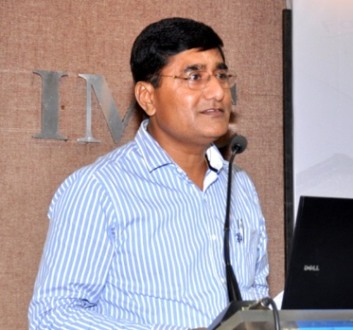
मेरी हाला में सबने पाई अपनी- अपनी हाला,
मेरे प्याले में सबने पाया अपना- अपना प्याला,
मेरे साकी में सबने अपना प्यारा साकी देखा,
जिसकी जैसी रूचि थी उसने वैसी देखी मधुशाला…….
K.M. Shahi

Slide 51


………for being such a
wonderful audience………….

